Slide 1
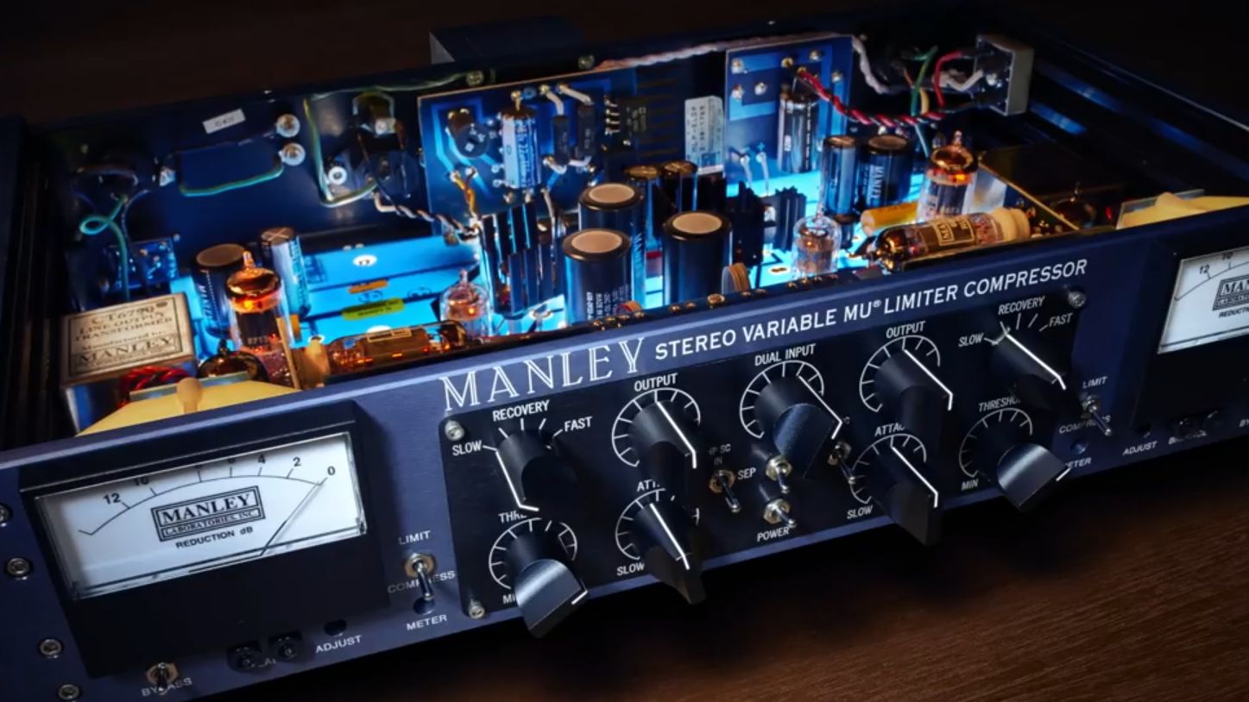

The Manley Variable Mu
Excellent tube compressor, but not an end-all

Slide 2
What makes a vari-mu?
Vari-mu
Mu (µ): Commonly refers to gain
Vari: Variable or changing
Tubes/Valves
A vacuum tube is used as the gain reduction component
Other compressors use tubes for make-up gain, but those are not vari-mu
Ratio
Vari-mu compressors are program-dependent, meaning ratio is determined by the input signal

Slide 3
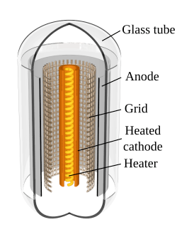
Vacuum Tubes (Valves)
An electrical device that controls current flow in a sealed vacuum between electrodes.¹
Current between the anode and cathode is
disrupted by the grid. The more input signal that
is applied to the grid, the more current is allowed to
flow.
Note that the cathode is heated, which is
why tube products must “warm up.”
¹https://foxmusicproduction.com/variable-mu-tube-compressors/

Slide 4
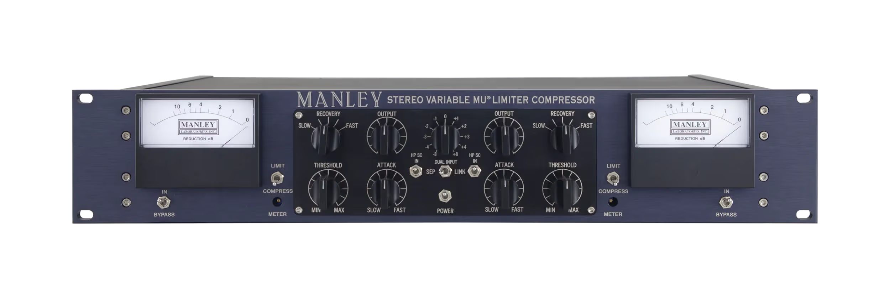
The Manley Variable Mu
Released in 1994
Nonlinear
Program-dependent
Well suited for “gluing” a mix together

Slide 5
The Manley Variable Mu
Attack: 25ms – 70ms
Recovery (Release):
VERY SLOW 8 seconds
SLOW 4 seconds
MEDIUM 600 ms
FAST 400 ms
VERY FAST 200 ms
(pretty slow)

Slide 6
The Manley Variable Mu
Threshold: The lower the threshold, the more that gets compressed.

Slide 7
The Manley Variable Mu
Dual Input (Input Gain): attenuation of input signal entering the amplifier limiting circuitry.¹
¹https://images.equipboard.com/uploads/item/manual/28965/manley-stereo-variable-mu-manual.pdf

Slide 8
The Manley Variable Mu
Output Attenuate: attenuation of output signal leaving the amplifier circuitry. Full attenuation occurs at the counterclockwise position.¹
¹https://images.equipboard.com/uploads/item/manual/28965/manley-stereo-variable-mu-manual.pdf

Slide 9
The Manley Variable Mu
Where’s the ratio control?
Remember, ratio is determined by the input signal. If you want harsher compression, send more input gain.
One small exception…

Slide 10
The Manley Variable Mu
Limit/Compress: Selects compression ( 1.5:1) or limiting (4:1) function. Compress is soft-knee, Limit is a sharper knee.¹
¹https://images.equipboard.com/uploads/item/manual/28965/manley-stereo-variable-mu-manual.pdf

Slide 11
For Mastering
The Manley Variable Mu provides gentle, warm tube compression.
Slow attack times mean smooth transitions without damaging dynamic range.
Produces sought-after tube saturation.

Slide 12
Attack – a strength and a weakness
Slow attack can be great for gently treating a mix bus without noticeably hurting the dynamic range.
However, the Manley Variable Mu’s slow attack times make it less useful for rapid transients.
For comparison, the UA1176 has attack times in the microseconds, which is something the Variable Mu cannot compete with.
Be careful with the settings if using the Variable Mu on sharp transient signals.

Slide 13
The Manley Variable Mu
The Manley Variable Mu is not designed to solve every problem, but its strengths make it a great vari-mu mastering compressor.
Understanding both its capabilities and its limitations is what ultimately allows it to serve the mix rather than reshape it.

